Slide 1

Student Details
NAME. : G.GIRI SAI PRAVEEN
COLLEGE. : SRK INSTITUTE OF TECHNOLOGY JUNE 3RD TO JULY 12TH
BRANCH : ECE Collage located: ANDHRA PRADESH
ROLL NO. : 22X41A0417. Gmail I'd : GIRISAIPRAVEEN@GMAIL.COM

Slide 2
PROJECT TITLE/Problem Statement
The main problem of sharing data between the users interference of the unauthorized users or parties.
Main aim of the communication over a network is that the data that is shared between the users must be secured and safely transferred.
So through our project we design a Steganography Algorithm that allows safe and secured data sharing.

Slide 3
AGENDA
Steganography is the use of various methods to hide information from unwanted eyes. In ancient times, steganography was mostly done physical.
The oldest documented case of steganography dates to 500 BC, in which Histiaeus, the ruler of Milteus, tattooed a message on the shaved head of one of his slaves and let the hair grow back. He then sent the slave to the Aristagoras, his son-in-law, who shaved the slave’s head again and revealed the message.
“Steganography by definition is the hiding of one file within another,” says Ira Winkler, lead security principal at Trustwave.

Slide 4
PROJECT OVERVIEW
The main purpose of the entire project on Data Hiding using Image Steganography is building a secured and a completely safe communication and data sharing.
Main aim on which we focused during the entire project is to hide the secret textual data behind the images in an efficient manner so that the changes in the original images should not be visible to the naked eyes.
This is a vital and an interesting field of information security that has various useful and Important applications like modern printers for encoding serial numbers, Intelligenc services (FBI, RFIS) for secret communication, copyrights protection, watermarking etc.

Slide 5
WHO ARE THE END USERS of this project?
Ransomware gangs have also learned that using steganography can help them carry out their attacks
Steganography can also be used in the data exfiltration stage of a cyberattack.
By hiding sensitive data within legitimate communications, steganography provides a means to extract data without being detected.

Slide 6
YOUR SOLUTION AND ITS VALUE PROPOSITION
Security: Image steganography provides a high level of security for secret communication as it hides the secret message within the image, making it difficult for an unauthorized person to detect it.
Efficiency: The image steganography technique should be efficient, i.e., it should be able to hide the secret information in the image quickly and effectively.
Concealment: The hidden information should be concealed in the image in a way that it is not easily distinguishable from the original image.
Retrieval: The hidden information should be retrievable by the authorized party using a decryption key or algorithm.

Slide 7
How did you customize the project and make it your own
Software Requirements: Python 3.9
Python Libraries
Pillow (PIL)
Numpy
OpenCV (cv2)
Tkinter(GUI)
OS module
Hardware Requirements:
Core i3 or higher,(cache- 3MB or 4MB recommended)
Memory(RAM): Minimum 2GB; Recommended 4GB or above

Slide 8
MODELLING
Basic Image steganography model has 2 Phases i.e. encoding and the decoding phase. Encoding phase involves creation of the “stego” image that has the original cover picture pixels embedded with the secret message bits at the least significant bits.
Then there is the second phase of steganography that has decoding part. It deals with the decoding of the stego image pixels for getting the least significant bits of the stego image which will be the secret bits embedded inside it.

Slide 9
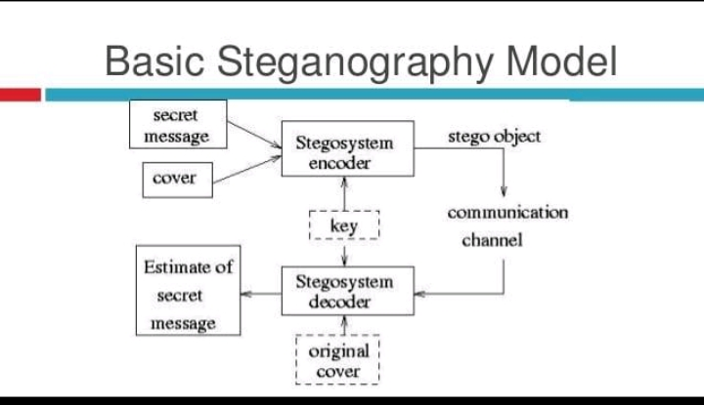
MODELLING
Basic Image steganography model has 2 Phases i.e. encoding and the decoding phase.
Encoding phase involves creation of the “stego” image that has the original cover picture pixels embedded with the secret message bits at the least significant bits.
Then there is the second phase of steganography that has decoding part. It deals with the decoding of the stego image pixels for getting the least significant bits of the stego image which will be the secret bits embedded inside it.

Slide 10
Results
The results of Image steganography project of ours works perfectly for the process of data hiding. Any cover image if not in PNG format, the function designed to convert images to PNG format does the work. The change in the original cover and stego object is negligible as last bit is changed only. So it is lossless form of compression and embedding. So the results and transmissions are highly accurate

Slide 11
links
Mohammed A. Saleh, “Image Steganography Techniques”. International Journal of Advanced Research in Computer and Communication Engineering (IJARCCE) (2018)
Arun Kumar Singh, Juhi Singh, Dr. Harsh Vikram Singh,
Steganography in Images Using LSB Technique (2015)”. International Journal of Latest Trends in Engineering and Technology (IJLTET)(2015)Johnson, Neil F/ Doric, Zoran / Jajodia, Information Hiding: Steganography and Watermarking Attacks and Countermeasures (Advances in Information Security, Volume 1)
Tayana Morkel, “IMAGE STEGANOGRAPHY APPLICATIONS FOR SECURE COMMUNICATION”. University of Pretoria, Pretoria May 2012.

Slide 12
THANK YOU

